Slide 1

BARDA’s MEDICAL COUNTER MEASURES COVID-19 VACCINES FUNDING.
(as of March 25th, 2021).
Biomedical Advanced Research and Development Authority (BARDA) (medicalcountermeasures.gov)

Slide 2
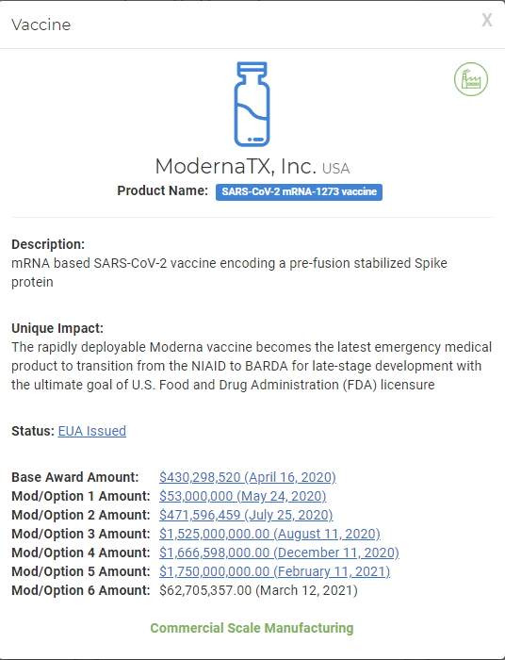
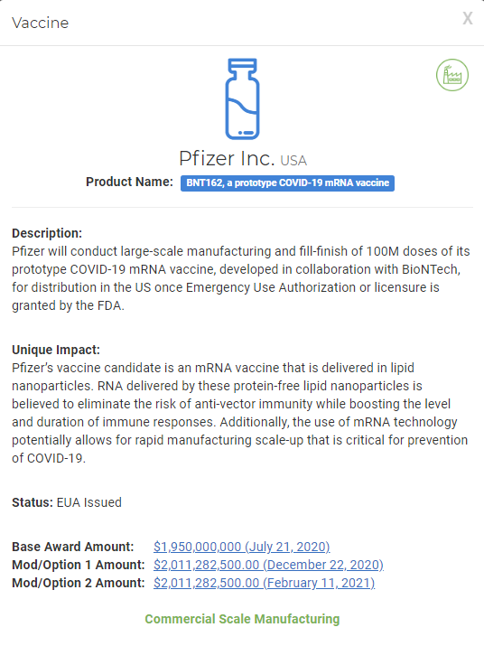
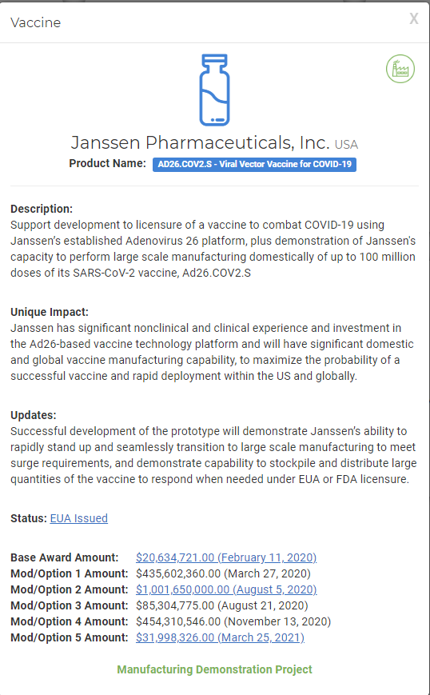
MedicalCountermeasures.gov - Coronavirus COVID-19
Medical Countermeasures | USA Public Health Security
Biomedical Advanced Research and Development Authority (BARDA) (medicalcountermeasures.gov)

Slide 3
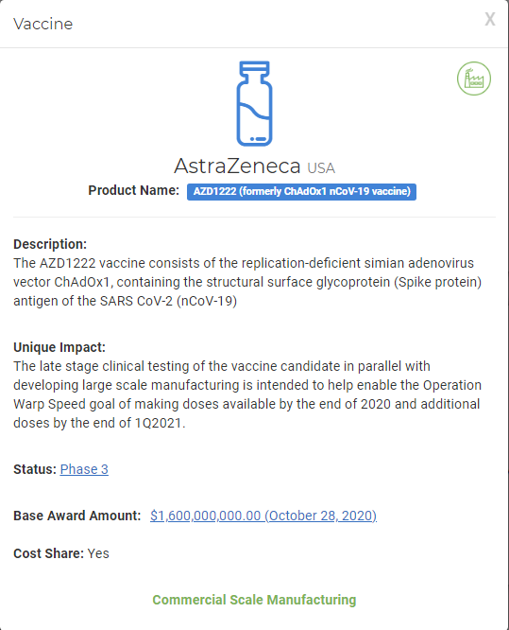
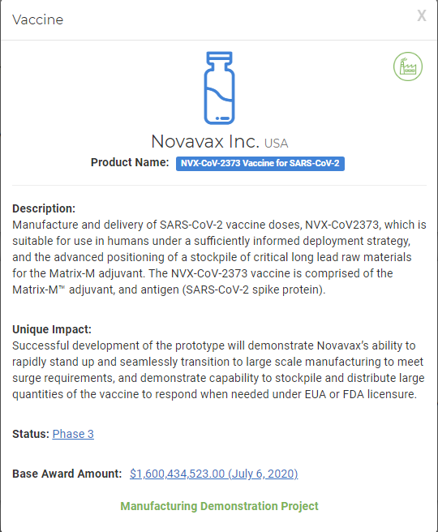
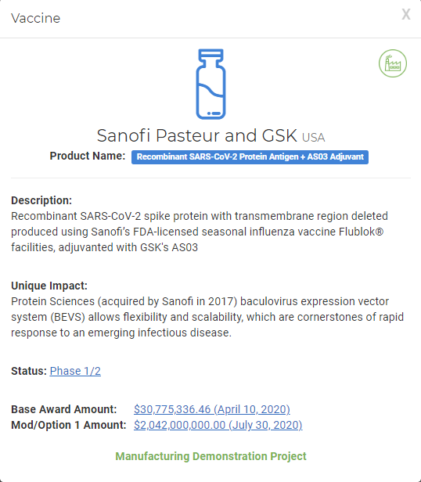
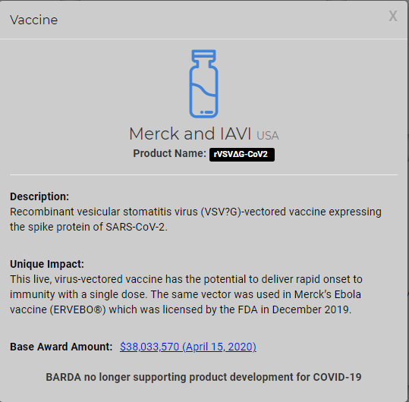
MedicalCountermeasures.gov - Coronavirus COVID-19
Medical Countermeasures | USA Public Health Security
Biomedical Advanced Research and Development Authority (BARDA) (medicalcountermeasures.gov)

Slide 4
DOES NOT USE abortion-derived cell line.
DOES USE abortion-derived cell line.
SOME tests DO NOT use abortion-derived cells, SOME DO.
� Currently undetermined.
Sponsor(s) | Country | Strategy | Clinical Trial Status | Public Funding | Design & Development | Production | Confirmatory Lab Tests
Moderna, Inc. with National Institutes of Health | USA | mRNA vaccine non-replicating “mRNA-1273” T7 RNA polymerase-mediated transcription from DNA plasmid template LNP (lipid nanoparticle) encapsulated Given: Intramuscular 2 doses (4 weeks apart) | FDA Emergency Use Authorization Approved Phase 3 Phase 2 Phase 1 | Operation Warp Speed HHS-BARDA $2,479,894,979 total CEPI up to $1 Million | Sequence designed on computer | No cells used Corbett et al., Nature , 5Aug2020 | protein test & pseudovirus HEK293 cells Corbett et al., Nature , 5Aug2020
Pfizer and BioNTech | USA Germany | mRNA vaccine non-replicating “BNT-162a1,b1,b2,b3,c2” nucleoside-modified mRNA in vitro transcribed by T7 polymerase from a plasmid DNA template LNP (lipid nanoparticle) encapsulated Given: Intramuscular 2 doses (3 weeks apart) | FDA Emergency Use Authorization Approved UK EUA granted Phase 2/3 Phase 1/2 Phase 1/2 Phase 1 Phase 1 | Operation Warp Speed HHS-BARDA $1.95 Billion | Sequence designed on computer | No cells used Vogel et al., bioRxiv 8Sept2020 | protein test & pseudovirus HEK293 cells Vogel et al., bioRxiv 8Sept2020
Janssen Research & Development, Inc. Johnson & Johnson | USA | Replication-deficient Adenovirus vector “Ad26.COV2-S” Given: Intramuscular 1 dose (some trials use 2 doses, 8 weeks apart) | FDA Emergency Use Authorization Approved Phase 3 Phase 3 Phase 1/2 | Operation Warp Speed HHS-BARDA $1,457,887,081 total | PER.C6 cells | PER.C6 cells Tostanoski et al., Nature Medicine, 3Sept2020; J&J, 30March2020; Janssen Vaccine Technologies
HEK-293: A kidney cell line isolated from an aborted fetus in 1973.
PER.C6: A retinal cell line isolated from an aborted fetus in 1985.
Analysis of SARS-CoV-2 (COVID-19) Vaccine Candidates (Last Updated 3 March 2021).

Slide 5
DOES NOT USE abortion-derived cell line.
DOES USE abortion-derived cell line.
SOME tests DO NOT use abortion-derived cells, SOME DO.
� Currently undetermined.
Sponsor(s) | Country | Strategy | Clinical Trial Status | Public Funding | Design & Development | Production | Confirmatory Lab Tests
AstraZeneca University of Oxford | USA UK | Replication-deficient Adenovirus vector “AZD1222” “ChAdOX1nCoV-19” Given: Intramuscular 2 doses (4 weeks apart) | UK EUA granted India EUA granted Phase 3 Phase 3 Phase 3 Phase 3 Phase 2/3 Phase 2/3 Phase 1/2 Phase 1/2 | Operation Warp Speed HHS-BARDA $1.2 Billion CEPI up to $384 Million | HEK293 cells | HEK293 cells van Doremalen et al., Nature, 30July2020 | HEK293 cells van Doremalen et al., Nature, 30July2020 MRC-5 cells Almuqrin et al., ResearchSquare 20Oct2020
Novavax | USA | Protein vaccine “NVX-CoV2373” Baculovirus expression plus Matrix M adjuvant Given: Intramuscular 2 doses (3 weeks apart) | Phase 3 Phase 3 Phase 2 Phase 1 | Operation Warp Speed HHS-BARDA $1,600,434,523 CEPI up to $388 Million |  | Sf9 insect cells Bangaru et al., Science, 27Nov2020 Bangaru et al., Supplement Bangaru et al., bioRxiv preprint, 6Aug2020; Graphical view | Pseudovirus HEK293 cells Bangaru et al., Science, 27Nov2020 Bangaru et al., Supplement Bangaru et al., bioRxiv preprint, 6Aug2020
Sanofi and GSK Protein Sciences | USA France | Protein vaccine Baculovirus expression plus AS03 adjuvant Given: Intramuscular 2 doses (3 weeks apart) | Phase 2 Phase 1/2 | Operation Warp Speed HHS-BARDA $2,072,775,336 total |  | Sf9 insect cells Baculovirus expressed recombinant protein ; | �
HEK-293: A kidney cell line isolated from an aborted fetus in 1973.
Analysis of SARS-CoV-2 (COVID-19) Vaccine Candidates (Last Updated 3 March 2021).

Slide 6
Vaccine Type | BARDA’s MCM TOTAL FUNDING | As Of
ModernaTX, Inc. USA. | 5,959,198,336 | March 12th, 2021.
Pfizer Inc. USA. | 5,972,565,000 | February 11th, 2021.
Janssen Pharmaceuticals, Inc. USA. | 2,029,500,728 | March 25th, 2021.
AstraZeneca USA. | 1,600,000,000 | October 28th, 2020.
Novavax Inc. USA. | 1,600,434,523 | July 6th, 2020.
Sanofi Pasteur & GSK, USA. | 2,072,775,336 | July 30th, 2020.
Merck and IAVI, USA. (BARDA’s Support Discontinued) | 38,033,570 | April 15th, 2020.
Biomedical Advanced Research and Development Authority (BARDA) (medicalcountermeasures.gov)

Slide 7
ALTERNATIVE COVID-19 VACCINES AT ADVANCED STAGE, FREE OF ABORTION-DERIVED CELL LINES ASSOCIATION, THAT BARDA’s MEDICAL COUNTER MEASURES NEEDS TO EXTEND FUNDING TO IMMEDIATELY TO REDUCE VACCINE HESITANCY, IMPROVE VACCINATION RATE, AND MEET RELIGIOUS & ETHICAL REQUIREMENTS OF AMERICAN CITIZENS.
Biomedical Advanced Research and Development Authority (BARDA) (medicalcountermeasures.gov)

Slide 8
Sponsor(s) | Country | Strategy | Clinical Trial Status | Public Funding | Design & Development | Production | Confirmatory Lab Tests
CureVac | Germany | mRNA vaccine non-replicating “CVnCoV” in vitro transcription lipid nanoparticle encapsulated Given: Intramuscular; 2 doses (4 weeks apart) | Phase 3 Phase 2/3 Phase 2 Phase 1 | CEPI up to $15.3 Million | Sequence designed on computer | No cells used Rauch et al., bioRxiv 9Feb2021 | Protein test Reticulocyte lysate, HeLa cells Rauch et al., bioRxiv 9Feb2021
Osaka University, AnGes, Takara Bio | Japan | DNA vaccine “AG0301-COVID19” “AG0302-COVID19” Chemically synthesized plasmid vector grown in E. coli Pressure injector Given: Intramuscular; 2 doses (2 weeks apart) | Phase 2/3 Phase 1/2 Phase 1/2 |  | Sequence designed on computer | No cells used E. coli</em Nishikawa et al., bioRxiv, 14Jan2021 | Virus neutralization Vero E6 cells monkey cells Nishikawa et al., bioRxiv, 14Jan2021
Zydus Cadila | India | DNA vaccine “ZyCov-D” Chemically synthesized plasmid vector grown in E. coli Given: Intramuscular; 3 doses (4 weeks apart) | Phase 3 Phase 1/2 |  | Sequence designed on computer | No eukaryotic cells used E. coli</em Dey et al., bioRxiv, 26Jan2021 | Expression analysis Plaque reduction Vero cells monkey cells Dey et al., bioRxiv, 26Jan2021 Yadav et al., bioRxiv, 3Feb2021
Beijing Institute of Biological Products/ Sinopharm | China | Inactivated virus “BBIBP-CorV” Given: Intramuscular; 2 doses (2 weeks apart) | Early approval in China Phase 3 Phase 3 |  | Vero monkey cells | Vero monkey cells | Cytopathic test
Wuhan Institute of Biological Products/ Sinopharm | China | Inactivated virus “New Crown COVID-19” Given: Intramuscular; 2 doses (2 weeks apart) | Phase 3 Phase 3 Phase 3 Early approval in China Phase 1/2 |  | Vero monkey cells Xia et al., JAMA 324, 951, 13Aug2020 | Vero monkey cells Xia et al., JAMA 324, 951, 13Aug2020 | Plaque reduction neutralization test Vero monkey cells Xia et al., JAMA 324, 951, 13Aug2020
Bharat Biotech/Indian Council of Medical Research | India | Inactivated virus “BBV152” Given: Intramuscular; 2 doses (2 weeks apart) | India EUA granted Phase 3 Phase 3 Phase 1/2 Phase 1/2 Phase 1/2 |  | Vero monkey cells Yadav et al., ResearchSquare 10Sept2020 | Vero monkey cells Yadav et al., ResearchSquare 10Sept2020 | Antibody ELISA Plaque reduction Vero monkey cells Yadav et al., ResearchSquare 10Sept2020
Institute of Medical Biology, Chinese Academy of Medical Sciences | China | Inactivated virus “SARS-CoV-2 vaccine”” Given: Intramuscular 2 doses (2 weeks apart) | Phase 3 Phase 1/2 Phase 1/2 |  | Vero monkey cells Pu et al., medRxiv, 6Oct2020 | Vero monkey cells Pu et al., medRxiv, 6Oct2020 | Antibody ELISA Neutralizing antibody cytopathic effect Vero monkey cells Pu et al., medRxiv, 6Oct2020 Supplement
ADCL – Abortion-derived Cell Line.
Status as of March 2021.
COVAXIN - India's First Indigenous Covid-19 Vaccine | Bharat Biotech
References: Update: COVID-19 Vaccine Candidates and Abortion-Derived Cell Lines | Charlotte Lozier Institute
COVID-19 - CureVac
Vaccine development (takarabio.com)
Covid 19_Booklet_9th FEB_FINAL.pdf (zyduscadila.com)
Chinese Covid-19 Vaccine Efficacy Better than Expected<br> Interview with Mr. Liu Jingzhen, Chairman of Sinopharm_HOME_国药党建网

Slide 9
JOIN THE CAMPAIGN FOR
EQUITABLE DISTRIBUTION
OF OUR TAX DOLLARS!

Slide 10
